Slide 1
btechcorp
Highly Conductive Z-axis Film Adhesives
www.btechcorp.com
Longmont, CO
Brentwood, TN

Slide 2
Product Concept
High conductivity fibers run through thickness of a film adhesive with precision orientation
  continuous path avoids particle-to-particle contact problem of filled adhesives
  wide range of fibers and thermoplastic matrices
    Graphite fibers, metallic coated and pure metal fibers (5 to 25 µ diameter). Up to 20 million fibers/in²
    Hot melt thermoplastics: polyamide, polypropylene, etc.
Fibers tilt slightly to allow consolidation of bond line during cure

Slide 3
HM-2 Thermoplastic Thermally Conductive Film Adhesive
40% volume graphite fibers

Slide 4
Less Conductive Adhesives Need Thin Bondline

Slide 5
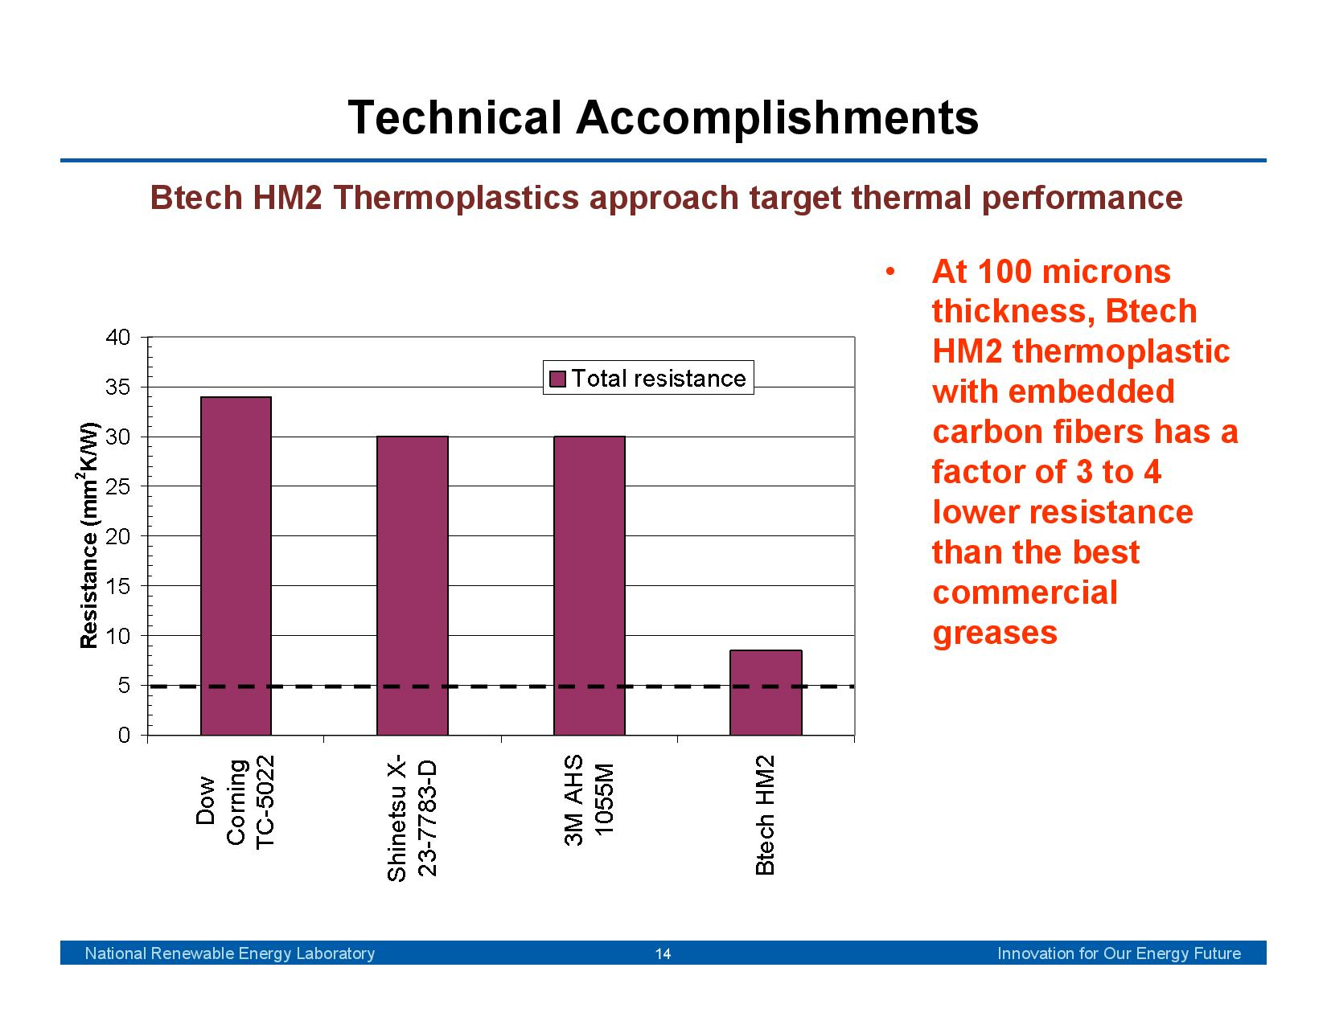
Greases Also Need Thin TIM Layer
(NREL testing)

Slide 6
HM-2 Thermoplastic Thermally Conductive Adhesive
0.06 °C-sq. cm/W Z-axis thermal resistance @100 microns
-50°C to +160°C operating range
Easy rework with heat and solvent
Special high temperature thermoplastic for automotive electronics
Other adhesive resins available

Slide 7
Applications
Power electronics
Satellite RF, heat pipe interface
Heat sinks
  pre-apply film for follow-on final assembly
Large die attach
Production IC testers
LED assemblies

Slide 8
Large Bond Area Thermal Cycling
Asian auto company: ceramic to Al
  3.8 x 2.3 cm, 100um HM-2
  3000 cycles -40⁰C to +105⁰C, no degradation
Production IC tester: one side bond to Cu
  2.6 x 3.9cm, 75um
  100,000s cycles -60⁰C to +125⁰C + pressure
NREL Vehicles Technology Program
  5 x 5cm, 100um, 2000 cycles -40 to +150⁰C (in process)

Slide 9
On-going Product Improvement Program

Slide 10
Recent Process Mods Added to Production Film
Less fiber height variation
More complete fibers
  split along axis (length)
  broken across axis
  crystal damage on fiber ends
Bare fiber treatment for better resin adhesion, bulk conductivity

Slide 11
Production Status
0.09
0.08
0.07
Baseline
0.06
Thermal
Status
0.05
●
Resistance
⁰C
sq.cm/W
0.04
-
Goal
0.03
0.02
0.01
0
0
100um
200um
300um
Bonded Joint Thickness
-

Slide 12
Future R&D Focus
Goal: 0.035 ⁰C-sq.cm/W @ 50um, 0.040 @ 100um
Key issue: phonon scattering at graphite/metal interface
  phonons are graphite heat transport, phonons + photons in metal
  acoustic mismatch between graphite/metal is key
Interposer treatment of fiber ends will be evaluated

Slide 13
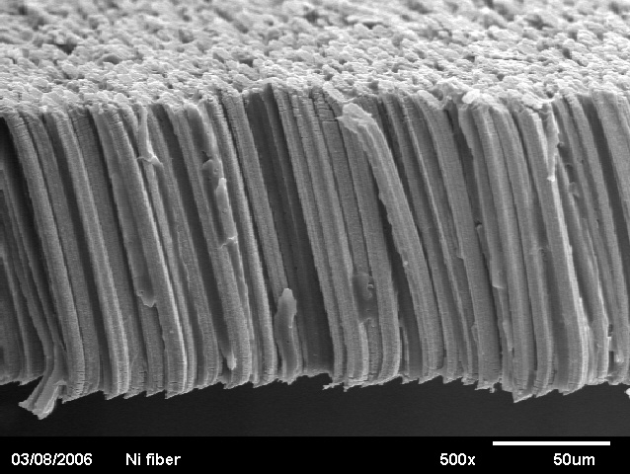
Electrically and Thermally Conductive
Film Adhesives
40% volume nickel fibers

Slide 14
Combined Electrically and Thermally Conductive ACF Adhesives
8µ diameter pure nickel fibers
- Bekaert (Belgium)
Instant “cure” hot melt thermoplastic
  - 125°C to 200°C bonding temperature options
  - 90°C to 160°C continuous operating capability

Slide 15
Combined Electrically and Thermally Conductive ACF Adhesives (cont’d)
Medium pitch density.…NTP series
- uncoated pure nickel fibers
- continuous process, <70% cost of high pitch version
High pitch density….TP series
  - ¼ µ thick green nickel oxide coating (NiO) on Ni fibers
  - >20 mega-ohm resistance on 30µ comb pattern
  - 11µ pitch capability

Slide 16
TP Series Product Requirements
Z-axis electrical resistivity
  ~0 µ-ohm (1.0 cm²)
X-Y electrical resistivity
  >20 megaohm, 30 µ pitch
Thermal conductivity 5 W/m°K (bonded joint)
  similar to Ag adhesives
Mechanical properties
  Very flexible: 0.06 GPa modulus, 77°K capability
  easy rework with solvent (IPA) or heat
  high lap shear and peel strength

Slide 17
TP Series Applications
Fine pitch BGA and flip chip packages
Flex circuit Z-axis interconnect
Advanced fine pitch displays (11µ pitch)
RFID tags

Slide 18
Significant Cost Savings for Flip Chips
Eliminates need for wafer bumping and underfill
  >65% cost savings for comm’l applications
Can be laminated to wafer before dicing or applied to component prior to assembly
  disk drive: pre-applied to flex circuit
  RFID tag: laminated to wafer
Low pressure bonding
  50 psi vs. >400 psi for current Z-axis adhesives

Slide 19
Numerous Devices Tested
MEMS cell phone microphone
Flex circuits
RF amp large area solder bond replacement
LED flip chip packaging
High density, hybridized CMOS imaging
  14,400 pixels, 100 µ² each

Slide 20
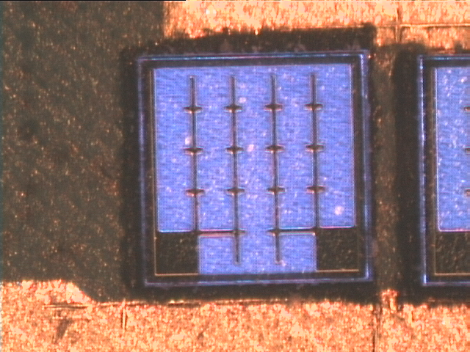
Prototype LED with Flip Chip Packaging
500 mA, 6V

