Slide 1

MH&W International Corp
TDK – CSC – TDG – Magnetec – CM Technology
November 2008

Slide 2
MH&W History
Founded September 1964
Formed in partnership with TDK Corp
TDK’s Agent for Ferrites in North America
2001 Expanding product offerings

Slide 3
MH&W Today
Distributor for TDK Corp Ferrite, Coil Formers and hardware
Master Distributor for Chang Sung ( CSC ) powder Cores ( MPP, High Flux, Sendust, Megaflux )
Distributor for TDG Ferrite Cores
Representative for TDG TECH ( EMS Activities)
Distributor of Magnetec Nanocrystalline Toroidal Cores
Distributor of CM Technology

Slide 4
TDK Corporation
Number 1 ferrite company in power material
Offers high perm material for EMI filter applications
Offers special materials for DSL transformers and Ethernet LAN applications
Our contacts are with TCA ( TDK Corporation of America )

Slide 5

TDK Corporation
November 2008 Update
Movement to China – TDK is in the process of moving the finishing operations of the Narita factory to Xiamen China. TDK will begin moving all operations to China in Marge – June, 2009
PC90 – PC95 – These new materials were designed to be used in planar magnetics. The materials are now being offered in many of the standard ferrite shapes
PC47 – This material is characterized by the lowest core losses of any material at 100 °C. The Xiamen factory is in the process of moving many of the core shapes from PC40/PC44 over to PC47. Eventually, PC47 will be the dominant power material being produced at the Xiamen factory. And it will become the “standard” power material.
PC95 is becoming the material of choice for operating in the 400KHz to 700KHz range.
PC50 is being phased out as it’s losses increase as the operating flux approaches 100mT.

Slide 6
TDK New Power Material PC95 and PC90 Standard TDK Cores
Material |  |  | PC95 | PC90 | PC47 | PC44 | PC40
Initial permeability | μ _{i} | 25 °C | 3300±25% | 2200±25% | 2400±25% | 2400±25% | 2300±25%
Core loss volume density |  | 25 °C | 350.0 | 680 | 600 | 600 | 600
at 100kHz, 200mT |  | 60 °C | 290.0 | 470 | 400 | 400 | 450
Typical Values | P_{cv}(kW/m³) | 80 °C | 280.0 | 380 | 300 | 320 | 400
 |  | 100 °C | 290.0 | 320 | 270 | 300 | 410
 |  | 120 °C | 350.0 | 400 | 360 | 380 | 500
Saturation magnetic flux density | β_{s}(mT) | 25 °C | 530.0 | 540 | 530 | 510 | 510
at 1000A/m |  | 60 °C | 480.0 | 510 | 480 | 450 | 450
Typical Values |  | 100 °C | 410.0 | 450 | 420 | 390 | 390
 |  | 120 °C | 380.0 | 420 | 390 | 350 | 350
Remanent flux density | β_{r}(mT) | 25 °C | 85.0 | 170 | 180 | 110 | 95
Typical Values |  | 60 °C | 70.0 |  | 100 | 70 | 65
 |  | 100 °C | 60.0 | 60 | 60 | 60 | 55
 |  | 120 °C | 55.0 |  | 60 | 55 | 50
Curie temperature | T_{c}(°C) | min. | 215 | 250 | 230 | 215 | 215
Density | ρ_{b}(kg/m³) |  | 4.9X10³ | 4.9X10³ | 4.9X10³ | 4.8X10³ | 4.8X10³
Unless otherwise specify the tolerance, the values are shown as a typical.

Slide 7
PC90 – PC95
Initial Perm verses Temperature

Slide 8
PC90 – PC95
Saturation Flux verses Temperature

Slide 10
PC90 – PC95
Core Loss verses Temperature

Slide 11
@100KHz

Slide 12
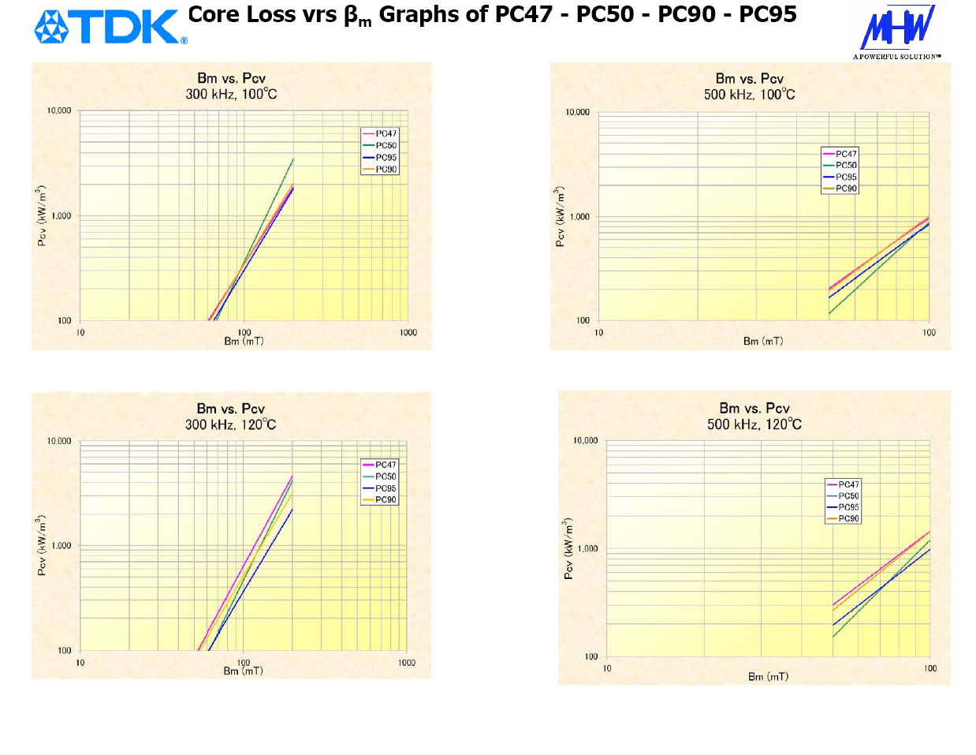

Slide 13
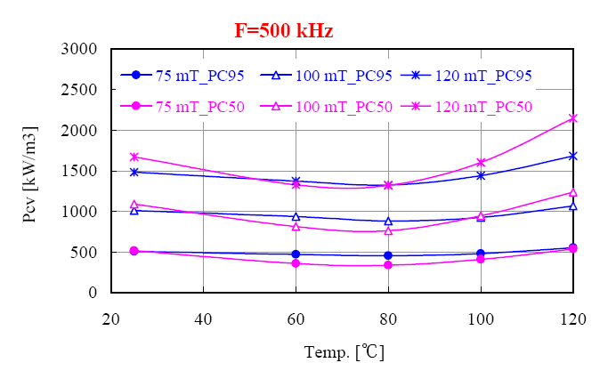
TDK PC95 verses PC50
High Frequency - High Flux Levels

Slide 14
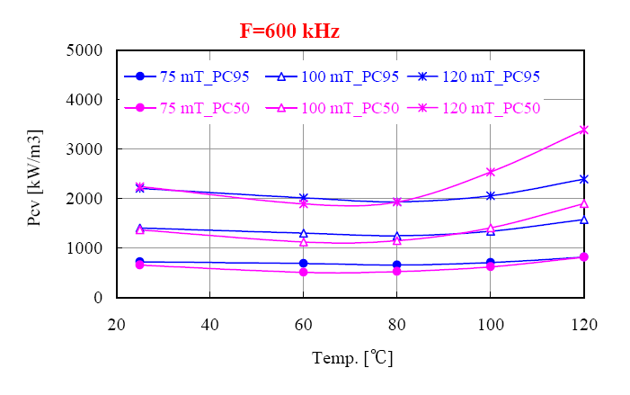
TDK PC95 verses PC50
High Frequency - High Flux Levels

Slide 15
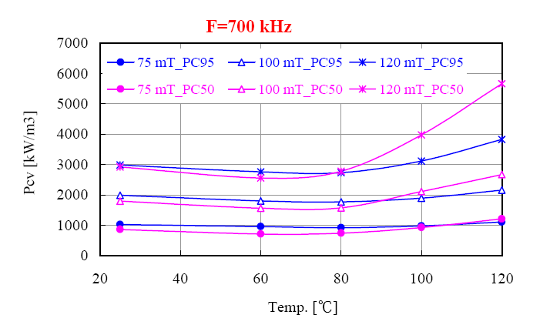
TDK PC95 verses PC50
High Frequency - High Flux Levels

Slide 16
PC90 PC95 Availability
Standard Core Shapes
Planar Core Shapes
Blocks for machining
  Custom Planar Designs Prior to Tooling
  PC90W33x27x16
  PC95W66x51x15

Slide 17


Available Core Sizes
Data as of October 8 2008
 | A_{e} | A_{cw} | ℓ_{e} | PC95 | PC90 | PC47 | PC40/PC44
 | ( mm² ) | ( mm² ) | ( mm ) | ± 25% | ± 25% | ± 25% | ± 25%
EER Series
EER25.5 | 44.8 | 79.4 | 48.2 | 2700 | 1650 | 2200 | 1920
EER28 | 82.1 | 114.0 | 64.0 | 4000 | 2800 | 3200 | 2870
EER28L | 81.4 | 148.0 | 75.5 | 3500 | 2600 | 2800 | 2520
EER35 | 107 | 218.0 | 90.8 | 4000 | 2900 | 3100 | 2770
EER40 | 149 | 249.0 | 98.0 | 5200 | 3500 | 4100 | 3620
PQ Series
PQ20/16 | 62 | 47.4 | 37.4 | 4480 | 3100 | 3880 | 3880
PQ20/20 | 62 | 65.8 | 45.4 | 4000 | 2700 | 3150 | 3150
PQ26/20 | 119 | 60.4 | 46.3 | 7470 | 5550 | 6170 | 6170
PQ26/25 | 118 | 84.5 | 55.5 | 6520 | 4500 | 5250 | 5250
PQ32/20 | 170 | 80.8 | 55.5 | 9120 | 6400 | 7310 | 7310
PQ32/30 | 161 | 149.6 | 74.6 | 7000 | 4900 | 5140 | 5140
PQ35/35 | 196 | 220.6 | 87.9 | 7320 | 4700 | 4860 | 4860
PQ40/40* | 201 | 326.0 | 101.9 | 6400 | 4300 | 4300 | 4300
PQ50/50* | 328 | 433.0 | 113.0 | 9700 | 6250 | 6720 | 6720
Low Profile Series
LP23/8 | 31.3 | 59.2 | 44.1 | 1900 | 1400 | N/A | 1600
LP22/13 | 67.9 | 84.2 | 49.0 | 3760 | 2700 | N/A | 3310
LP32/13 | 70.3 | 125.3 | 64.0 | 3240 | 2200 | N/A | 2630
RM Series
RM4 | 14 | 15.6 | 22.7 | 1300 | 1000 | N/A | 680 min
RM5 | 23.7 | 18.2 | 22.4 | 2200 | 1700 | N/A | 1250 min
RM6 | 36.6 | 26.0 | 28.6 | 3040 | 2100 | N/A | 2450
RM8 | 64 | 48.9 | 38.0 | 5000 | 3000 | N/A | 1950 min
RM10 | 98 | 69.5 | 44.0 | 6300 | 4200 | N/A | 4850
RM12 | 140 | 110.0 | 56.9 | 6500 | 5050 | N/A | 4150 min
RM14 | 178 | 155.0 | 69.0 | 9300 | 6100 | N/A | 4600 min
* Large cores require alternate manufacturing procedures

Slide 18
Available Core Sizes
Data as of October 8 2008
 | A_{e} | A_{cw} | ℓ_{e} | PC95 | PC90 | PC47 | PC40/PC44
 | ( mm² ) | ( mm² ) | ( mm ) | ± 25% | ± 25% | ± 25% | ± 25%
EPC Series
EPC10 | 9.39 | 7.7 | 17.8 | 1040 | 900 | N/A | 1000
EPC13 | 12.5 | 23.0 | 30.6 | 1060 | 800 | N/A | 870
EPC17 | 22.8 | 18.7 | 40.2 | 1500 | 1100 | N/A | 1150
EPC19 | 22.7 | 54.4 | 46.1 | 1400 | 940 | N/A | 940
EPC25 | 46.4 | 85.5 | 59.2 | 2200 | 1400 | N/A | 1560
EPC25B | 33.3 | 62.1 | 46.2 | 2200 | 1400 | N/A | 1560
EPC27 | 54.6 | 108.0 | 73.1 | 2200 | 1400 | N/A | 1540
EPC30 | 61 | 60.4 | 55.9 | 2300 | 1700 | N/A | 1570
EE Series
EE10/11 | 12.1 | 23.3 | 261.0 | 1040 | 700 | N/A | 850
EE13 | 17.1 | 34.3 | 302.0 | 1350 | 1050 | N/A | 1130
EE16 | 19.2 | 40.3 | 34.6 | 1450 | 1050 | N/A | 1140
EE19 | 23 | 55.5 | 39.6 | 1550 | 1050 | N/A | 1250
EE25/19 | 40 | 79.0 | 48.7 | 2200 | 1500 | N/A | 2000
EE30 | 109 | 75.6 | 58.0 | 6300 | 3900 | N/A | 4690
EE40 | 128 | 160.5 | 77.0 | 5700 | 3500 | N/A | 4150
EI Series
EI12.5 | 14.4 |  | 21.3 | 1400 | 950 | N/A | 1200
EI19 | 24 |  | 39.6 | 1550 | 1250 | N/A | 1400
EI28 | 86 |  | 48.2 | 5100 | 3800 | N/A | 4300
EI33/29/13 | 119 |  | 67.5 | 5600 | 3800 | N/A | 4400
EI50 | 230 |  | 94.0 | 8300 | 5700 | N/A | 6110
EP Series
EP7 | 10.3 |  | 15.7 | 1500 | N/a | N/A | 830 min
EP10 | 11.3 |  | 19.2 | 1380 | N/a | N/A | 800 min
EP13 | 19.5 |  | 24.2 | 2100 | N/a | N/A | 1170 min
EP17 | 33.9 |  | 28.5 | 2900 | N/a | N/A | 1840 min

Slide 19
PC90 PC95 Planar Cores
PC44-PC47 Obsolete for Planar Cores
EL 11/4 → EL 25/9.6
ELT 11/3 → ELT 25/9.6
PQI 16/7.8 → PQI 26/11.5
EIR 14/4.5/9 → EIR 22/5.5/15
ER 14/4.5/9 → ER 25/5.5/18
EI 14/5/5 → EI 22/8/16
RMI4 – RMI5 – RMI6 – RMI7 – RMI8
EQ13 – EQ20 – EQ25
EER25.5 – EER28
Custom Planar Configurations

Slide 20
Xiamen
PC40 → PC44 → PC47
TDK EE CORES | TDK EI CORES | TDK EER CORES
PC44 EE 8 | PC44 EI 12.5 | PC44 EER 25.5
PC44 EE 10/11 | PC44 EI 16 | PC44 EER 28
PC44 EE 12.6 | PC44 EI 19 | PC44 EER 28L
PC44 EE 13 | PC44 EI 22/19/6 | PC44 EER 35
PC44 EE 16 | PC44 EI 25 | PC44 EER 40
PC44 EE 19 | PC44 EI 28 | PC44 EER 42
PC44 EE 19/16 (E187) | PC44 EI 30 | PC40 EER 42/42/15
PC44 EF 20 | PC44 EI 33/29/13 | PC40 EER 42/42/20
PC44 EE 25/19 (E24/25) | PC44 EI 35 | PC40 EER 49
PC44 EF 25 | PC44 EI 40 | PC40 EER 49L
PC44 EE 30 | PC40 EI 50 | TDK PQ CORES
PC44 EE 30/30/7 (M30) | PC40 EI 60 | PC44 PQ 20/16
PC44 EF 32 | TDK ETD CORES | PC44 PQ 20/20
PC44 EE 35/28B (E375) | PC44 ETD 24 | PC44 PQ 26/20
PC40 EE 40 | PC44 ETD 29 | PC44 PQ 26/25
PC40 EE 41/33C (E21) | PC44 ETD 34 | PC44 PQ 32/20
PC40 EE 42/42/15 (M42/15) | PC44 ETD 39 | PC44 PQ 32/30
PC40 EE 42/42/20 (M42/20) | PC40 ETD 44 | PC44 PQ 35/35
PC40 EE 50 | PC40 ETD 49 | PC44 PQ 40/40
PC40 EE 55/55/21 (M55) | ---- | ----

Slide 21
Chang Sung Corp
CSC largest producer of powder cores in the world
Facilities in Inchon, Korea with HQs in Seoul
New Factory in Waihai, China
  Change of process change for Sendust Material Old process – Spray Dry of powder to obtain grain size
  New process – Dry bulk powder and grinding dry ball mill process to obtain grain size
  New Process - Lower Losses

Slide 22
Sendust Core Loss
Core Loss (mW/cc) |  | 26 u | 60u | 75u | 90u | 125u
Core Loss Before New Process | Min | 300 | 290 | 282 | 296 | 274
 | Ave | 350 | 306 | 298 | 306 | 295
 | Max | 400 | 322 | 314 | 316 | 315
Core Loss After New Process | Min | 150 | 236 | 229 | 256 | 257
 | Ave | 200 | 268 | 265 | 271 | 277
 | Max | 250 | 300 | 301 | 285 | 296
Mag Inc | Samples | 225 | 235 ~ 260 | 258 ~ 323 | 228 ~ 239 | 239 ~ 369
Arnold | Samples | 350 | 323 | 260 ~ 295 |  | 250 ~ 371

Slide 23
TDG Corporation
Largest Manufacturer of Ferrites in the World
Haining City – 3 hours SW Shanghai
MnZn and NiZn Ferrite
Largest Selection of Cores
New Materials
Custom Tooling costs extremely low ~$1,500

Slide 24
TDG Corporation
Ferrite core materials
 | Initial Perm | Equivalent To | Comments
TP4A | 2,400 | PC44/3F3
TP4D | 2,500 | PC47 | Lowest Losses @ 100°C
TP4W | 3,000 | PC95/N95/3C95 | Wide Band Temp Response
TP4F | 1,800 | none | High Temp – 140°C Opn
TP5B | 1,200 | none | 1 – 2 MHz Opn
TLD5 | 5,000 | none | Temp Range -40°C to +65°C
TS10 | 10,000 | H5C2 | EMI Filter
TS10A | 10,000 | T72 | EMI Filter

Slide 25
TDG Corporation
EMI Ferrite Sample Kit
TDG Sample Kit For EMI Filters | Dimensions |  |  | Al Value | A_{e}
 | O.D. | I.D | TH | nH/Tn² | mm²
TS10 T31/20/15E | 31.0 ± 0.6 | 20.0 ± 0.6 | 15.0 ± 0.4 | 12940 min | 81.2
TS10 T22.1/13.7.6.5E | 22.1 ± 0.6 | 13.7 ± 0.6 | 6.5 ± 0.2 | 4400 min | 26.8
TS10 T12.7/7.9/6.35E | 12.7 ± 0.4 | 7.6 min | 6.35 ± 0.3 | 5500 min | 15.8
TS10 T9/5/3E | 9.0 ± 0.3 | 4.7 min | 3.0 ± 0.3 | 3760 min | 5.8
TS5 T22.1/13.7/12.7E | 22.1 ± 0.6 | 13.7 ± 0.6 | 12.7 ± 0.4 | 5690 ± 30% | 52.2
TS5 T22.1/13.7/6.5E | 22.1 ± 0.6 | 13.7 ± 0.6 | 6.5 ± 0.2 | 3050 ± 30% | 26.8
TS5 T12.7/7.9/6.35E | 12.7 ± 0.4 | 7.6 min | 6.35 ± 0.3 | 2350 ± 30% | 15.8
TS5 T9/5/3E | 9.0 ± 0.3 | 4.7 min | 3.0 ± 0.3 | 1192 min | 5.8
TP4A T31/19/8E | 31.0 ± 0.6 | 19.0 ± 0.6 | 8.0 ± 0.3 | 1750 ± 25% | 47.1
TP4A T9/5/3E | 9.0 ± 0.3 | 4.7 min | 3.0 ± 0.3 | 790 ± 25% | 5.8

Slide 26
TDG Technology
Company formed in 2005 to provide competitive Electronic Manufacturing Services ( EMS )
Headquarters in Jiaxing, China, 2 hours west of Shanghai
Follows the principles of “Hi-Investment, Hi-Standard and Hi-Tech”
Current assets of over $330 Million
Over 300,000 ft² clean room manufacturing

Slide 27
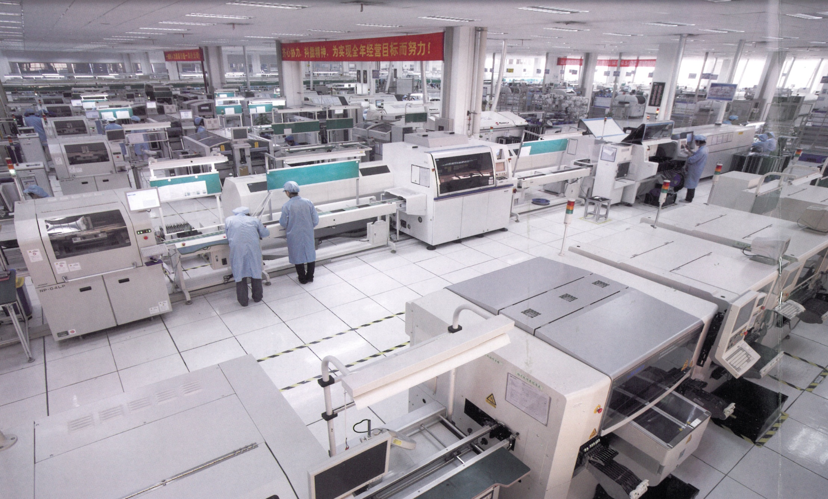
TDG-TECH Manufacturing

Slide 28

TDG-tech Product development & engineering
Magnetic parts and modules design for customer
PCB Layout
Hardware Design
Embedded Software and System Development
Design for Manufacturability (DFM)
Design for Testing
Prototyping
New Product Introduction (NPI)

Slide 29
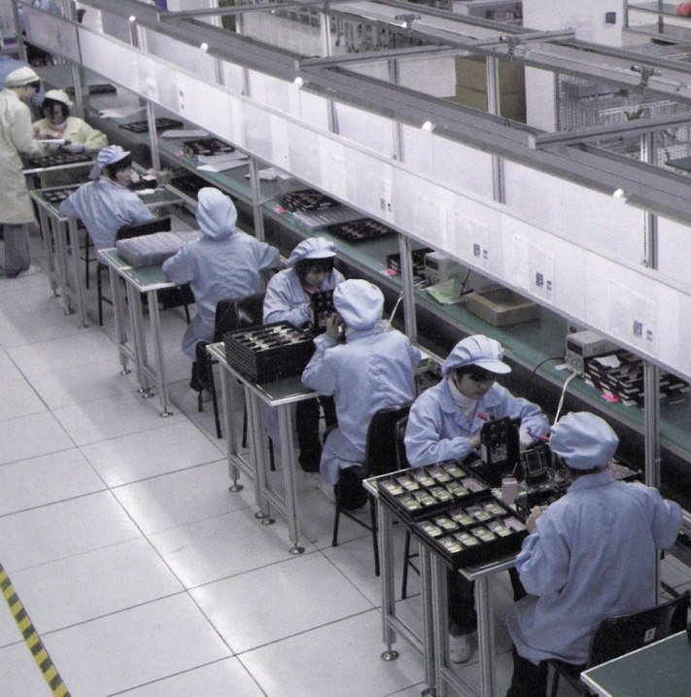
TDG-tech manufacturing
Materials Sourcing and Management
PCBA and Component Assembly Services
Sub-Assembly Services
Complete Box Build
Automatic Testing Equipment (ATE) Development
Conformal Coating
Potting
Burn-In
Bar-Code Traceability System
Failure Analysis and Reliability Testing
Supply Chain Localization

Slide 30
Magnetec GmbH
Manufacturer of Iron based Nanocrystalline cores. They have developed
their own processes to manufacture these cores to achieve very specific
characteristics to specific industries.
Cool Blue – Cool Blue cores are used in Inverter – motor drive systems. By
using the Cool Blue cores in a common mode choke configuration, the
parasitic voltages that cause pitting and failure on the motor bearings
are reduced or eliminated. As a result the life of the bearings in the motor
in extended 2x – 4x the normal wear and tear.
EMI Filters – The use of Magnetec Nanocrystalline cores reduces the size
of the filter while maintaining like performance.

Slide 31
Magnetec GMBH
Nanocrystalline
Saturation Flux Density | 1,200 mT
Permeability | 25,000—90,000 @ 10KHz
Saturation Magnetostriction | < 0.5 ppm
Spec. Electrical Resistivity | 115 μΏcm
Density | 7.35 g/cm³
Curie Temperature | 600°C
Max. Operating Temperature | 120°C
Core Losses (100KHz, 300mT, sine wave) | > 110 W/kg
Alloy Composition | Fe _{73.5} Cu ₁ Nb ₃ Si _{15.5} B ₇

Slide 32
Magnetec GMBH
Nanocrystalline
Graphs demonstrating the variable range of Hysteresis Loops and Permeability Levels

Slide 33
Magnetec gmbh
EMI Cores
µ ~ 80,000 ( @ 10 KHz )
Type | Dimensions Nominal OD x ID x TH ( mm ) | Dimensions Physical OD x ID x TH ( mm ) | Mass ( gm ) | Path Length l_{e} ( cm ) | Core Area A_{e} ( cm² ) | Al Value ( µH ) | Finish C=Case E=Epoxy
M-017 | 16 x 10 x 6 | 17.8 x 8.2 x 8.0 | 4.3 | 4.0 | 0.14 | 30.0 -60.0 | C
M-059 | 20 x 12.5 x 8 | 22.3 x 10.3 x 10.0 | 9.0 | 5.1 | 0.24 | 33.0 –67.0 | C
M-053 | 25 x 20 x 10 | 27.6 x 17.8 x 12.5 | 10.5 | 7.1 | 0.20 | 21.2 –41.3 | C
M-003 | 25 x 16 x 10 | 28.0 x 13.2 x 12.4 | 17 | 6.4 | 0.36 | 45.0 –89.0 | C
M-102 | 30 x 20 x 10 | 32.7 x 17.8 x 12.6 | 23.1 | 7.8 | 0.40 | 40.0 –80.0 | C
µ ~ 25,000 - 30,000 ( @ 10 KHz )
M-036 | 16 x 10 x 6 | 17.8 x 8.0 x 8.0 | 4.3 | 4.0 | 0.14 | 8.0 –18.0 | E
M-042 | 20 x 12.5 x 8 | 21.5 x 10.5 x 10.1 | 9.0 | 5.0 | 0.24 | 12.6 –25.3 | E
M-033 | 25 x 16 x 10 | 26.6 x 13.7 x 12.3 | 17.1 | 6.3 | 0.36 | 12.6 –28.0 | E
M-030 | 30 x 20 x 15 | 32.3 x 17.5 x 17.3 | 33 | 7.9 | 0.57 | 17.4 –39.0 | E
M-014 | 40 x 32 x 15 | 42.3 x 29.1 x 17.3 | 40 | 11.3 | 0.48 | 10.7 –21.4 | E
M-011 | 50 x 40 x 20 | 52.3 x 37.1 x 22.3 | 83 | 14.1 | 0.80 | 12.6 –28.4 | E
M-012 | 60 x 40 x 15 | 62.3 x 37.1 x 17.3 | 138 | 15.5 | 1.20 | 17.4 –39.0 | E
M-018 | 63 x 50 x 20 | 65.5 x 46.6 x 22.8 | 129 | 17.8 | 1.00 | 13.2 –29.7 | E
M-022 | 80 x 63 x 20 | 83.0 x 59.5 x 22.8 | 213 | 22.5 | 1.24 | 13.8 –31.0 | E
M-226 | 100 x 80 x 20 | 104 x 75.0 x 23.0 | 333 | 28.3 | 1.60 | 12.6 –28.3 | E
M-028 | 130 x 100 x 25 | 134.5 x 95.0 x 28.5 | 757 | 36.0 | 2.85 | 18.6 –42.0 | E
M-190 | 160 x 110 x 25 | 165 x 105 x 28.5 |  | 41.99 | 4.61 | 24.0—50.0 | E

Slide 34
Magnetec gmbh low cost cores
NANOPERM® Low Cost Cores for Small EMI Filter Chokes
M-306 | 16 x 11 x 5 | 18.4 x 8.6 x 7.0 |  | 4.2 | 0.1 | 5.9 –11.8 | C
M-307 | 20 x 15 x 5 | 22.4 x 12.6 x 7.5 |  | 5.5 | 0.1 | 4.5 –9.1 | C
M-308 | 25 x 20 x 5 | 27.7 x 17.1 x 7.5 |  | 7.0 | 0.1 | 3.5 –7.0 | C
M-309 | 30 x 25 x 5 | 32.7 x 22.0 x 7.5 |  | 8.6 | 0.1 | 2.8 –5.7 | C
M-310 | 40 x 35 x 5 | 42.5 x 31.8 x 7.5 |  | 11.8 | 0.1 | 2.1 –4.2 | C
M-333 | 50 x 45 x 5 | 52.2 x 41.8 x 7.5 |  | 14.9 | 0.1 | 1.6 –3.3 | C
M-334 | 60 x 55 x 5 | 62.0 x 51.6 x 7.5 |  | 18.1 | 0.1 | 1.3 –2,8 | C
M-335 | 70 x 65 x 5 | 72.0 x 61.4 x 7.5 |  | 21.2 | 0.1 | 1.1 –2.3 | C

Slide 35
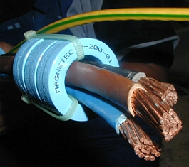
Magnetec gmbh cool blue cores
Cool Blue® toroids made from the nanocrystalline material NANOPERM are being used increasingly to reduce damaging motor bearing currents in modern high power inverter systems operating at high switching frequencies. As a result of these unwanted currents, the bearings corrugate, leading to electrical breakdown in the lubrication and finally to a standstill of the entire motor.
The use of Cool Blue® cores not only significantly reduces the over voltage peaks at the motor terminals, but also suppresses the asymmetrical EMI currents which are generated by the parasitic currents of the motor itself together with the motor cable. In order to achieve an efficient reduction in these destructive effects, one or more Cool Blue® of suitable geometry have to be placed together over the connector cables in the DC-link as well as at the inverter output. In this configuration, the cores operate as a common-mode choke.
This method significantly increases the service life of the motor bearings and thus reduces maintenance costs and standstill periods.

Slide 36
Magnetec gmbh cool blue cores
TYPE | Core Nominal OD x ID x TH (mm) | Physical OD (max) x ID (min) x TH (max) (mm) | Mass (gm) | Path Length (l_{e}) (cm) | Core Area (A_{e}) (cm²) | AL Value @ 10KHz (μH) | Current Icm (A)
M-112 | 63 x 50 x 30 | 68.0 x 43.0 x 36.0 | 204 | 17.7 | 1.44 | 23.3—46.6 | 4
M-113 | 80 x 63 x 30 | 86.0 x 55.0 x 36.0 | 338 | 22.4 | 2.04 | 24.1—48.2 | 6
M-283 | 80 x 63 x 30 | OVAL | 338 | 22.4 | 2.04 | 24.1—48.2 | 6
M-114 | 100 x 80 x 30 | 108 x 70.0 x 36.0 | 500 | 28.2 | 2.40 | 22.5—45.0 | 8
M-284 | 100 x 80 x 30 | OVAL | 500 | 28.2 | 2.40 | 22.5—45.0 | 8
M-115 | 130 x 100 x 30 | 135 x 92.0 x 36.0 | 958 | 35.9 | 3.60 | 26.4—52.9 | 9
M-142 | 130 x 100 x 30 | OVAL | 604 | 36.7 | 2.22 | 16.0—32.0 | 8
M-116 | 160 x 130 x 30 | 165 x 123 x 34.0 | 1,208 | 45.4 | 3.60 | 20.9 x 41.9 | 12
M-302 | 160 x 130 x 30 | OVAL | 1,208 | 45.4 | 3.60 | 20.9 x 41.9 | 12
M-117 | 200 x 175 x 30 | 208 x 166 x 37.0 | 1,302 | 58.82 | 2.78 | 12.3—24.6 | 16
M-111 | 240 x 200 x 30 | OVAL | 2,219 | 69.9 | 4.32 | 16.4—32.8 | 20
M-248 | 300 x 254 x 30 | OVAL | 3,242 | 86.7 | 5.04 | 15.3—30.5 | 22
M-205 | 300 x 250 x 30 | 304 x 246 x 34.0 | 3,722 | 86.2 | 5.85 | 18.0 x 36.0 | 23
M-503 | 500 x 450 x 30 | 504 x 446 x 36.0 | 6,430 | 149.1 | 5.85 | 10.3—20.7 | 40

Slide 37
CM Technology
China Manufacturing Technology
Company founded and developed to be a manufacturers agent and marketing/advertising company to promote China manufacturers
Operates as a sourcing company for China goods and services
Has key contacts with magnetic industries in mainland China
MH&W Int’l is the authorized North American Agent for CM Technologies products and services

Slide 38
CM Technology
North American Ferrite Industry
Large Ferrites
EMI Ferrites
Coil Formers

Slide 39
Cm Technology
Coil Formers

Slide 40
CM Technology
Large Ferrites

Slide 41
CM Technology ferrites for power & EMI

Slide 42
CM Technology
EMI Ferrites
CM Technology Part Number | ＴＤＫ ＰＡＲＴ ＮＯ
ＢＮＦ１１３０ | ＺＣＡＴ２１３２－１１３０
ＢＮＦ１３３０ | ＺＣＡＴ３０３５－１３３０
ＢＮＦ１５２５ | ＺＣＡＴ１３２５－０５３０
ＢＮＦ１５２８
ＢＮＦ１７３０ | ＺＣＡＴ１７３０－０７３０
ＢＮＦ１２
ＢＮＦ１４
ＢＮＦ１８
ＢＮＦ２７
ＢＮＦ０９３０ | ＺＣＡＴ２０３５－０９３０
ＢＮＦ１２Ｈ | ＺＣＡＴ１５１８－０７３０
ＢＮＦ１０１０
ＢＮＦ１５１２
ＢＮＦ０８２２
ＢＮＦ０９１７ | ＺＣＡＴ２０１７－０９３０
ＢＮＦ０９３０Ａ | ＺＣＡＴ２０３２－０９３０

Slide 43





Thank You !

